Slide 1
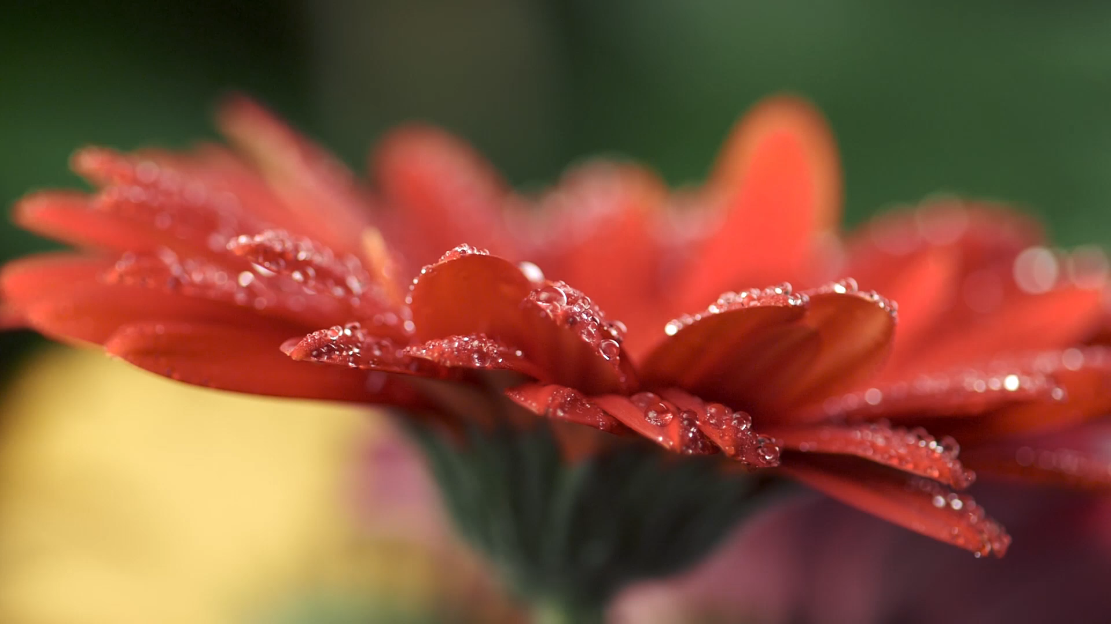
FLOWER SHOW IN A BOX
(Also known as the NGC Small Standard Flower Show)

Slide 2
MISSION
TO INCREASE THE NUMBER OF SMALL
STANDARD FLOWER SHOWS AND
EDUCATIONAL SERVICES TO NGC
FEDERATED GARDEN CLUB MEMBERS ON A
LOCAL CLUB OR COUNCIL
LEVEL
To increase the number of SMALL STANDARD FLOWER SHOWS and educational services to FEDERATED GARDEN CLUB members on a local club level.

Slide 3
DESCRIPTION:
A CLUB-FRIENDLY PROGRAM DESIGNED TO MOTIVATE AND
ENCOURAGE SMALL OR INEXPERIENCED GARDEN CLUBS
OR CLUBS THAT HAVE NOT HAD A FLOWER SHOW IN
SEVERAL YEARS, TO HOST A SMALL STANDARD FLOWER
SHOW. THIS PROGRAM CAN ALSO BE USED AS A
WORKSHOP TO
UPDATE MORE EXPERIENCED CLUBS ON HANDBOOK
DESIGNS, HORTICULTURE AND POLICY
CHANGES.

Slide 4
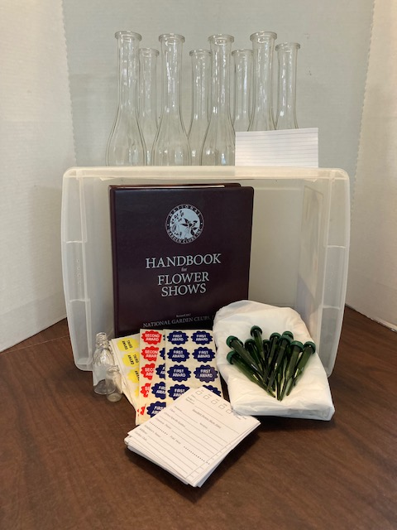
FLOWER SHOW IN A BOX:
EVERYTHING YOU NEED TO STAGE A SMALL STANDARD FLOWER SHOW CAN BE CONTAINED IN A SPACESAVER TYPE STORAGE TUB. THIS ONE HAPPENS TO BE 10” TALL X 15” LONG AND 12” WIDE. BUT YOU COULD DECORATE AND USE A HAT BOX OR ANYTHING THAT WOULD HOLD ALL YOUR ITEMS SAFELY.

Slide 5
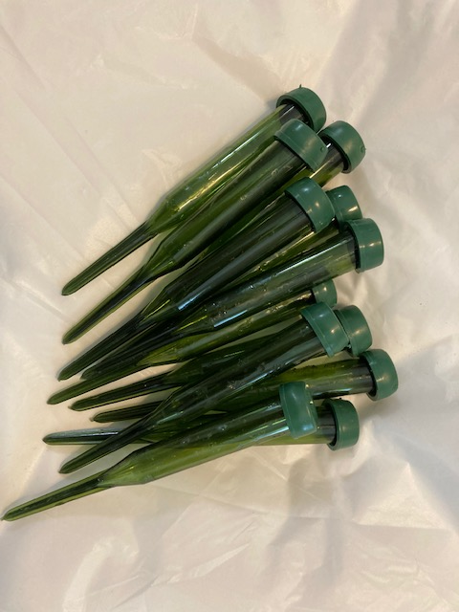
WATER PICKS WITH OR WITHOUT ‘STEMS’
USE THESE TO HOLD SOME OF THE FLOWERS OR GREENERY THAT WILL BE ENTERED IN YOUR SHOW…..YOU CAN STICK THEM IN STYROFOAM TO KEEP THEM UPRIGHT AND SEPARATE THEM INTO CLASSES THAT WAY.

Slide 6
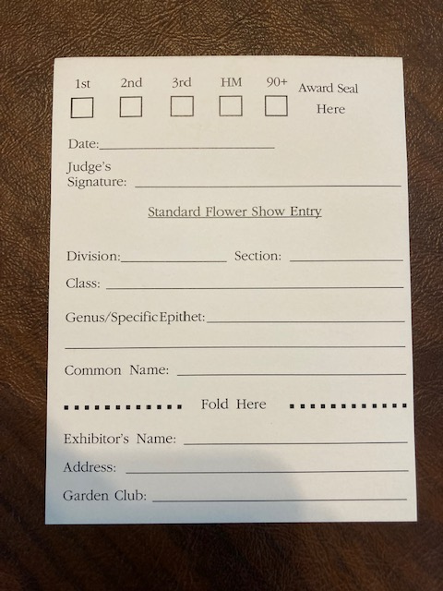
ENTRY CARDS
WHETHER YOU USE THE ENTRY CARDS FROM NATIONAL GARDEN CLUBS’ HQ OR HAVE TRIPLICATE ONES PRINTED AS YOU SEE HERE, YOU NEED TO HAVE ENTRY CARDS….

Slide 7
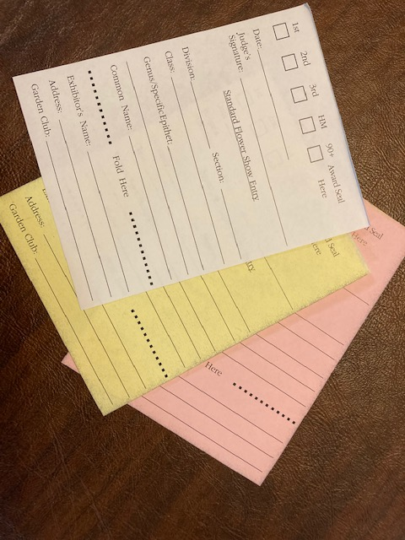
TRIPLICATE ENTRY
TAGS
HAVING TRIPLICATE ENTRY CARDS IS A TIME SAVER….FILL THEM OUT; ENTRIES WILL KEEP THE PINK COPY, HAVE CLERKS TAKE THE YELLOW COPY TO TABULATIONS/AWARDS AS THEY ARE JUDGED AND LEAVE THE WHITE COPY ON THE EXHIBIT…..WITH THIS METHOD, THERE ARE NO CLERK’S SHEETS AND TABLULATIONS/AWARDS IS READY TO TELL YOU ALMOST IMMEDIATELY WHO YOUR WINNERS ARE!!!

Slide 8
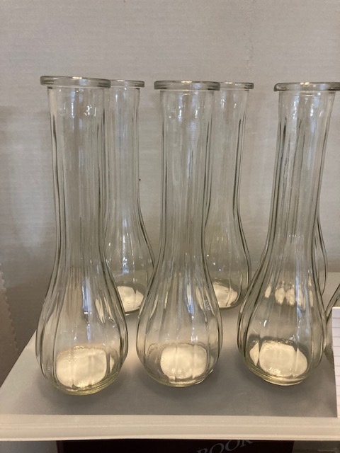
HORTICULTURE
DEPENDING ON WHAT IS INCLUDED IN YOUR HORTICULTURE DIVISION, YOU MAY NEED REGULAR SIZED BUD VASES; SOME ARBOREAL SPECIMENS CAN BE LAID ON THE TABLE-TOP WITHOUT WATER; SOME ITEMS MAY BE SMALL AND FIT A WATER TUBE….YOU’LL NEED TO HAVE ENOUGH FOR THE MINIMUM OF 20 HORTICULTURE ENTRIES REQUIRED…OR EXHIBITORS CAN BRING THEIR OWN CONTAINERS.
NOTE: be specific about what type container the exhibitor can bring!!!

Slide 9
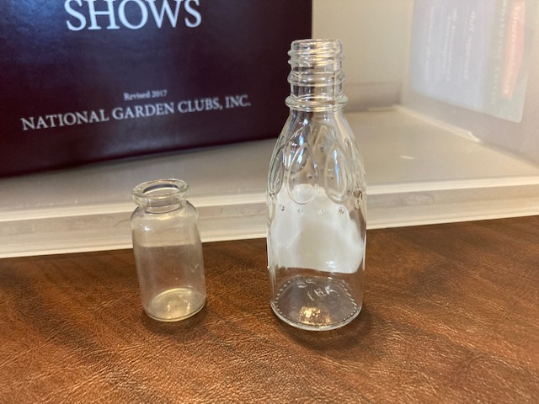
SMALL HORTICULTURE
AGAIN, DEPENDING ON WHAT YOU EXPECT TO BE ENTERED OR HOW YOU WRITE THE SCHEDULE, YOU MAY FIND YO NEED SMALL CONTAINERS SUCH AS THE SYRUP BOTTLE FROM CRACKER BARREL RESTAURANT OR A SERUM VIAL FROM THE VET’S OFFICE.

Slide 10
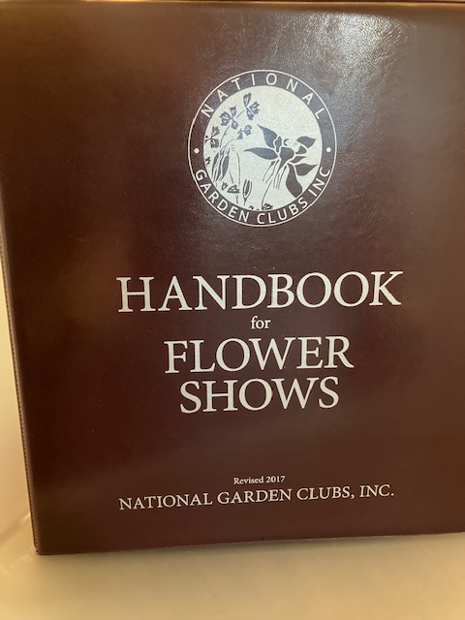
THE HANDBOOK FOR FLOWER SHOWS
YOU WILL NEED TO HAVE THE 2017 HANDBOOK FOR FLOWER SHOWS AND BE SURE TO PRINT ANY CHANGES TO THE HANDBOOK FROM THE WEBSITE. YOUR HANDBOOK IS THE ULTIMATE AUTHORITY FOR ANY FLOWER SHOW.

Slide 11
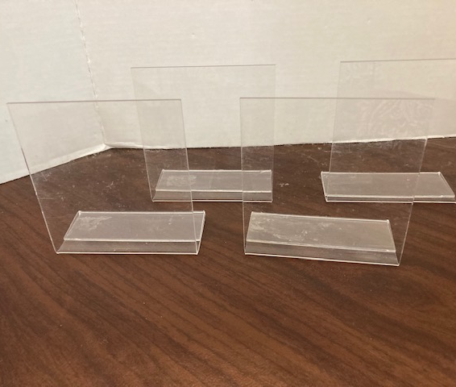
SIGNAGE
THESE HAPPEN TO BE ACRYLIC STAND-UP PHOTO HOLDERS, BUT WE HAVE USED THEM HERE FOR SIGNAGE FOR YOUR SMALL STANDARD FLOWER SHOW.

Slide 12
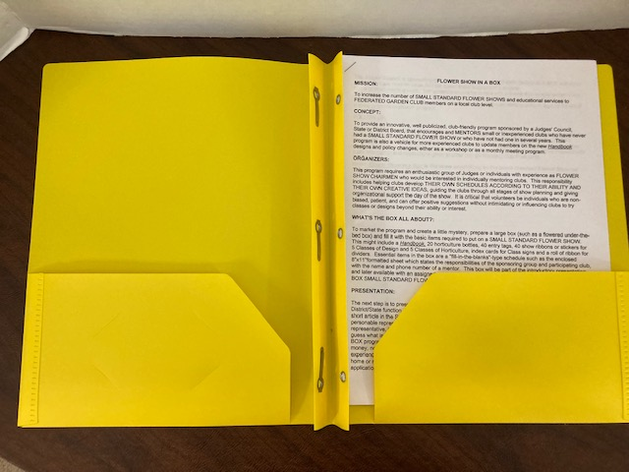
MANUAL FOR THE
SMALL STANDARD
FLOWER SHOW
THIS 7 PAGE MANUAL GIVES YOU A SAMPLE SCHEDULE TO ‘FILL IN THE BLANKS’, DIRECTIONS ON HOW TO SET UP THE SSFS IN YOUR CLUB OR COUNCIL AND WHO TO CONTACT WITH QUESTIONS.
DON’T LOSE IT

Slide 13
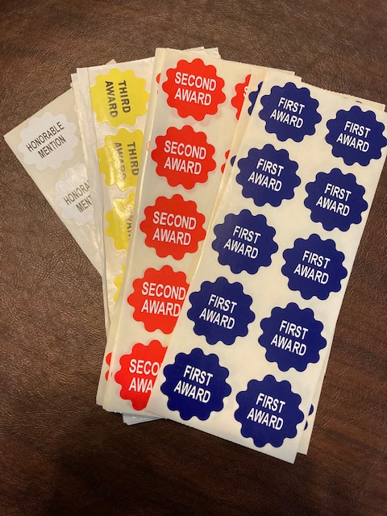
RIBBONS, STICKERS AND AWARDS
FEEL FREE TO USE THE STICKERS AS PICTURED (100 FOR $10.00) OR YOU CAN SMALL OR REGULAR SIZED RIBBONS FROM NGC OR MAKE YOUR OWN…UP TO YOU SO LONG AS YOU STATE WHAT THE COLORS STAND FOR IN THE SCHEDULE.
THERE ARE NOW 90+ STICKERS AVAILABLE…ORDER THOSE IF YOU LIKE.

Slide 14
Other items you may need to have in your FSIAB
Plastic tablecloths (Dollar Store party section) for at least two 6’ tables…black for designs and white for horticulture exhibits.
Index cards for comments and signage.
Hole punch for entry tags
Ribbon to mark off sections.
Something for wedging.
Small stapler to attach ribbon if not using stickers.

Slide 15
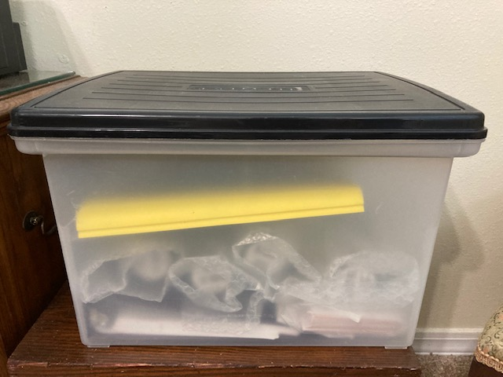
Flower Show in a Box
Probably not the prettiest presentation you could have, but everything you need to stage a Small Standard Flower Show is included in this box….yes, everything!!! And it is easy to carry and store!
The idea is to have this all assembled in something that is easy to use and lightweight enough to carry.
NOTE: bubble wrap helps keep glass vases from breaking.
Spend a few dollars and have it ready to lend (rent?) to a local club or another council so they can stage a Small Standard Flower Show…mentor and help each other….earn exhibiting and judging credits….and you can apply for an NGC Flower Show Achievement Award for your show (FS5, A, B, or C and FS 6,7,and 8)

